Slide 1
Markov-based Time Series Modeling
for Temperature State of Traffic-Network

Slide 2
ABSTRACT
A Markov model is used to estimate the probability that one state transits to another state after a given time period . In Markov Chain we predict the position of future state based only on the present state(most recent state). Markov models can be an effective way of prediction in time series. In this project, a Markov based time series model is built to analyse the state of temperature of “Metro Interstate Traffic Volume” data set taken from the UCI ML repository.

Slide 3
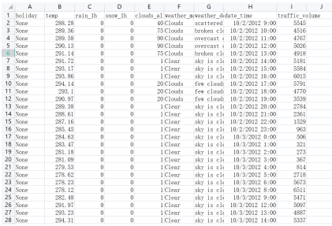
DATA DESCRIPTION
This dataset talks about traffic network conditions by integrating archived and real-time data under various external conditions, including holiday, temperature, cloud coverage and weather conditions between the year of 2012 and the year of 2018.

Slide 4
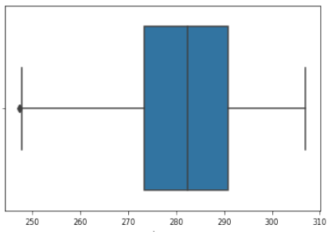


DATA PREPRATION
In this step temperature column was chosen to analyse, and hourly data points of year 2017 were selected. At this stage data points were visualized in a box plot , temperature under 247.36 and over 316 is considered as an outlier. IQR approach was used to find outliers and corresponding rows were removed.

Slide 5
DATA MAPPING
In order to map our data into a Markov chain, we first calculate the minimum and maximum and then get the range of our data points which is approximately 59.23. Therefore, we decide to choose 6 states and allocate each temperature to a specific state.
Associated computation :
STATE | 1 | 2 | 3 | 4 | 5 | 6
TEMP | 248<T<258 | 258<T<268 | 268<T<278 | 278<T<288 | 288<T<298 | 298<T<308

Slide 6
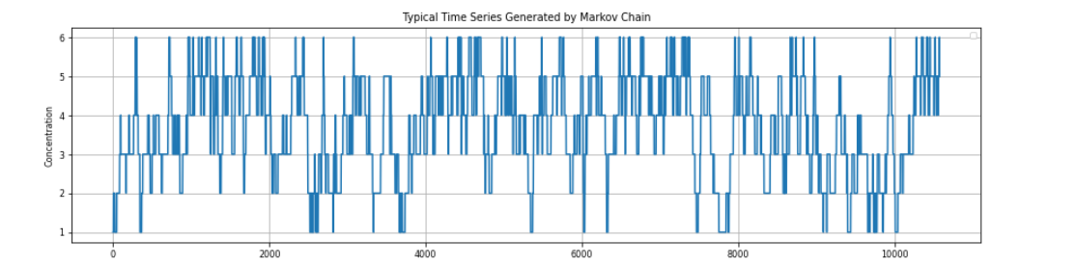
Building the Markov Chain
The Markov states are {1,2,3,4,5,6} . Here is a time series graph of the 10000 datapoints taken from 2017’s data.

Slide 7
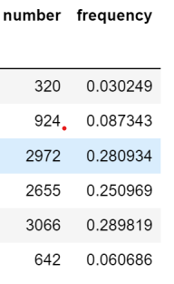
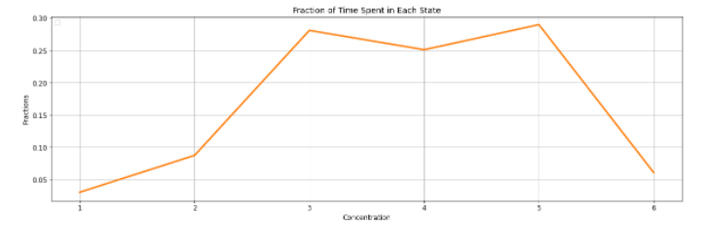
Empirical distribution from time series
Next step is to compute the occupation frequencies for each state and turn this into a probability distribution. This is the empirical distribution of our chain.
Empirical distribution from time series is the fraction of time spent in each state.

Slide 8
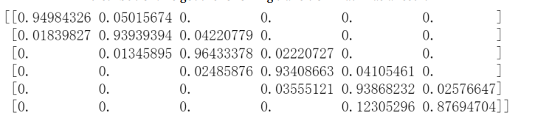

Computation of Transition Matrix and Stationary Distribution
Transition Matrix :
Stationary Distribution
To compute the transition matrix, which is essentially a representation of probability that our Markov state goes from one state to another, for this time series which follows the above distribution. We got the following transition matrix as a result
To compute the limiting probability vector a.k.a the stationary distribution which tell us the long term probability distribution of our markov states.
Let W be the stationary vector
W=(w1,w2,w3,w4,w5,w6)

Slide 9
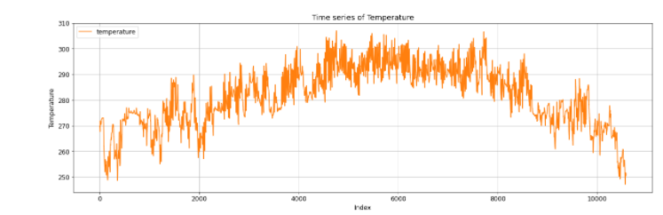
Time Series Plot
In this step, considering 10000 datapoints of Year 2017 I investigated the time series plot of the original data. Here x-axis is the index of each data point (corresponding to hourly stamps)and the y-axis is the value of temperature.

Slide 10
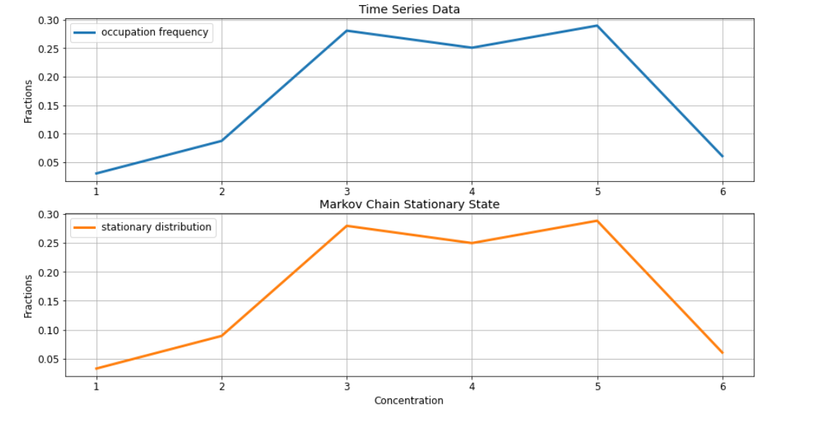
Comparing the empirical distribution of the data set and the stationary distribution of the chain
Empirical distribution from time series compared to the stationary distribution of chain
The plot of the Markov State vs Normalized Frequency for original time series is similar which is an indication that the frequency distribution of the original data wasn’t disturbed.

Slide 11
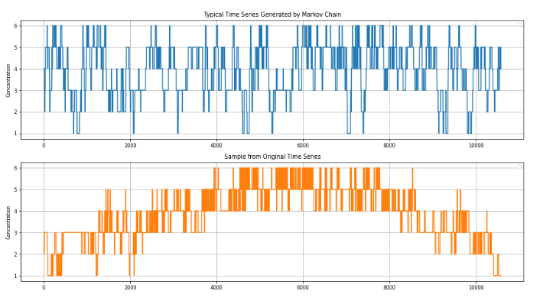
Comparing Time Series Plot with our simulated Time series

Slide 12
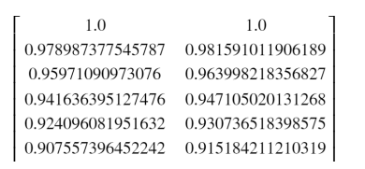

Evaluation for this Model
Auto-correlation function:
Auto correlation is the correlation between two observations at different points in a time series.
The correlation values for original time series and simulated time series are given in the following table: (we took K=30 , this is a sample of 6 values)

Slide 13
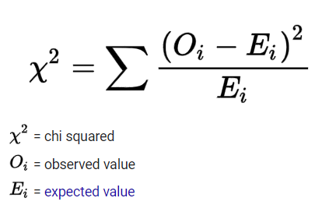
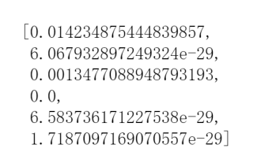
Goodness Of Fit using Chi Test
Using Chi square test, I calculated Chi values and then corresponding P values . P-values for each Markov state is given here ->

Slide 14
Conclusion
Since all the p-values are less than 0.05(significance level) we will reject the null hypothesis that our dataset is a good fit for Markov model. Hence, we will reject all the states. From the previous table, we see that none of the states can be accepted by our hypothesis. Thus, I do not consider that the Markov chain method produces a good model for this time series.

Slide 15

Thank you!

